Slide 1
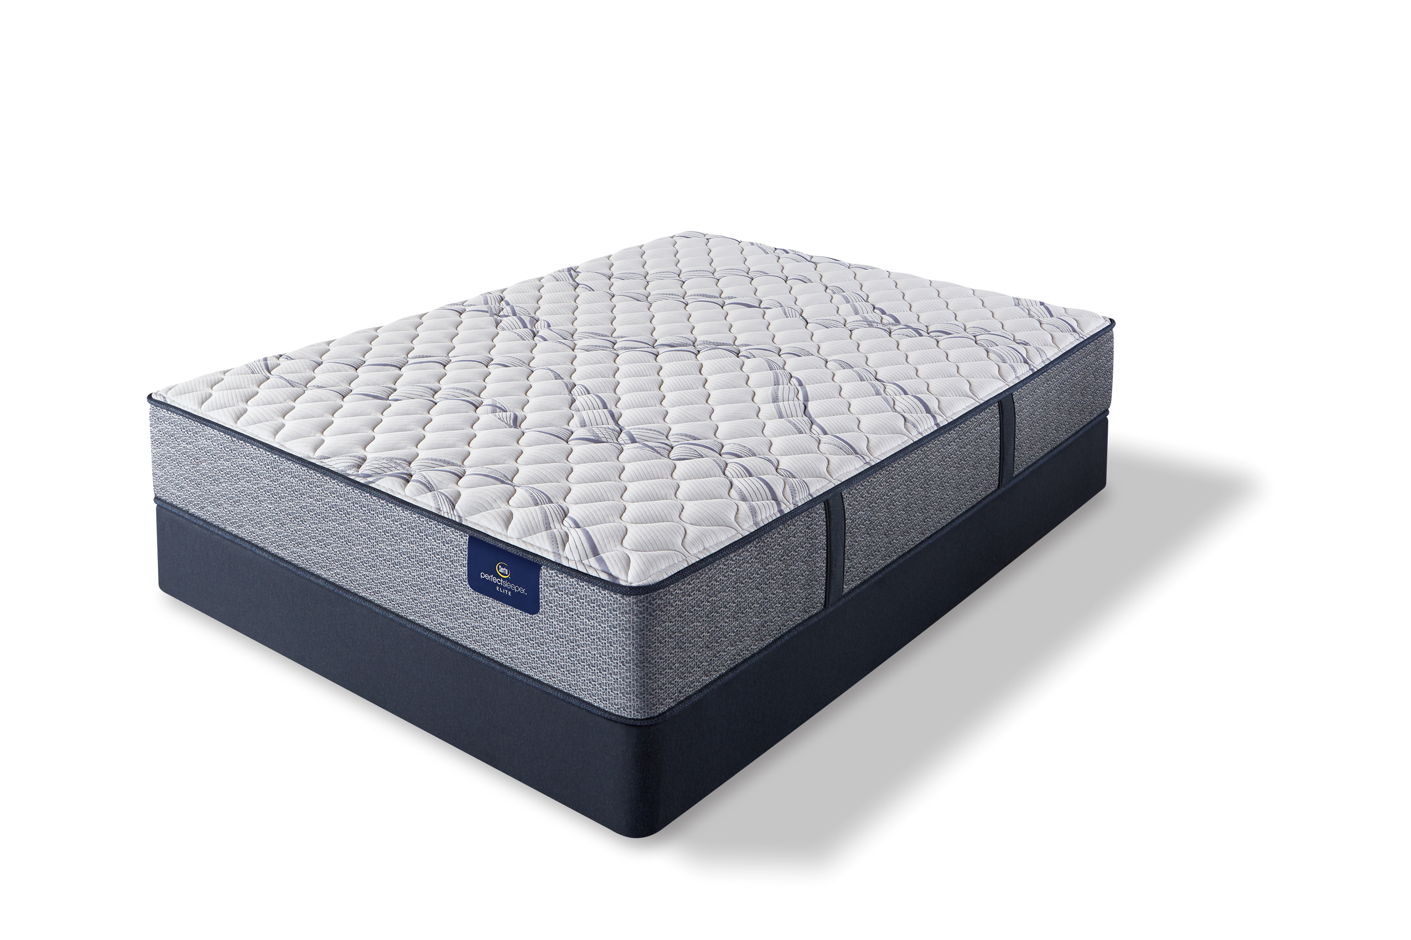
FREE MEMORY FOAM PILLOW
FREE MATTRESS PROTECTOR
FREE DELIVERY
FREE REMOVAL
* See store for details

